Slide 1

Story 4 – How much do we get Paid?
Jennifer Abinette

Slide 2

Data sources
Average salary by state retrieved 10/21/23 from salary.com website. https://www.salary.com/research/salary/
Skills referenced in job description retrieved 10/22/23 from ziprecruiter website. https://www.ziprecruiter.com/career/Data-Scientist/Resume-Keywords-and-Skills

Slide 3
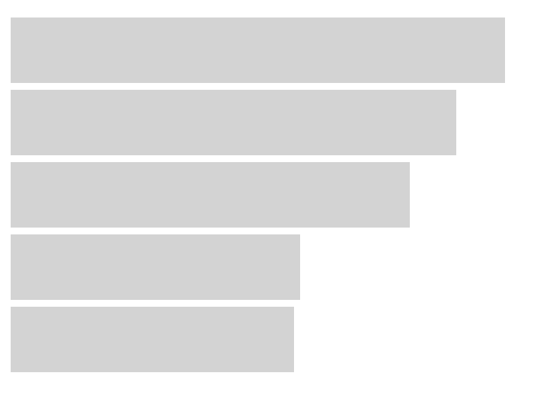
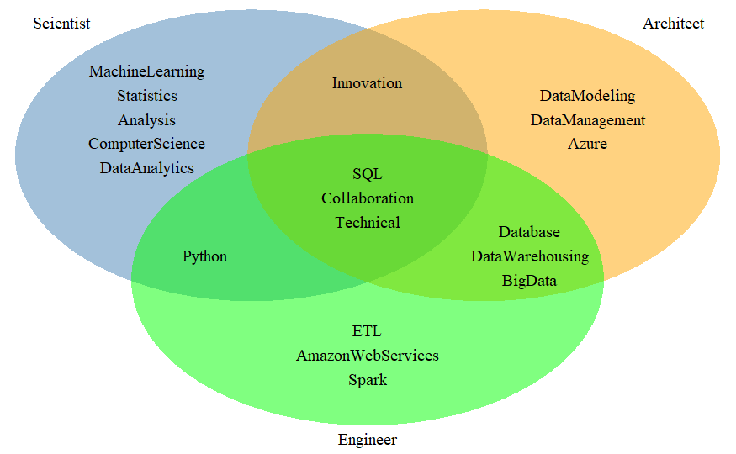
What Job Title Pays the Most?
Average Salary by Title
Source: https:// www.salary.com
Top Skills Mentioned in Job Description
Source: https://www.ziprecruiter.com
$ 141 K
Scientist
Architect
Data Scientist
Data Architect
Data Engineer
Data Analyst
Business Analyst
$ 128 K
$ 114 K
$ 83 K
$ 81 K
Engineer

Slide 4
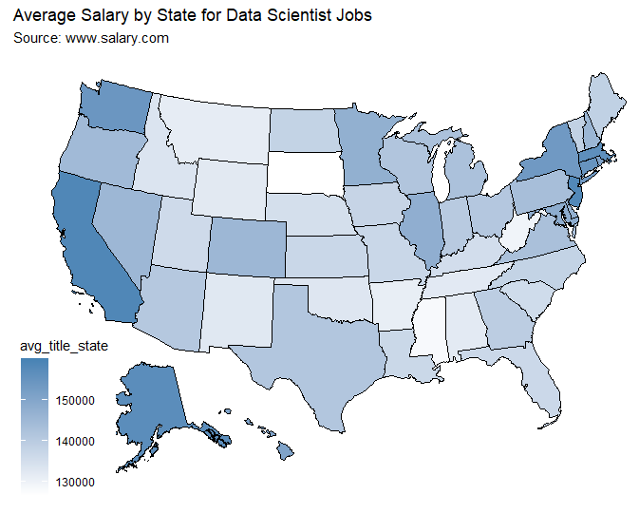
What State Pays the Most?
Rank | State | Avg Salary
1 | California | $ 158,453
2 | New Jersey | $ 158,152
3 | Alaska | $ 156,729
4 | Massachusetts | $ 156,341
5 | Connecticut | $ 154,833
46 | Montana | $ 131,329
47 | Arkansas | $ 130,914
48 | West Virginia | $ 129,360
49 | Mississippi | $ 128,113
50 | South Dakota | $ 126,590

